Slide 1

Using Time-Series-Forecasting Techniques to Analyze and Predict UAE Trade
Group C

Slide 2


Agenda
Introduction
Phase 1 (Midterm)
Phase 2
Predictions in conflict abroad, local conflict, pandemics, natural disasters

Slide 3





Meet the Team
JAke
Nathan
Hend
Jake
Gabe
Michael

Slide 4
Introduction
We hypothesize that through the application of these techniques, we can accurately forecast trade flows of the UAE, empowering businesses and policymakers to drive economic growth within the region.

Slide 5

Phase 1
Predicting imports and exports into United Arab Emirates (UAE), Bahrain, Kuwait, Oman, Qatar, and Saudi Arabia

Slide 6
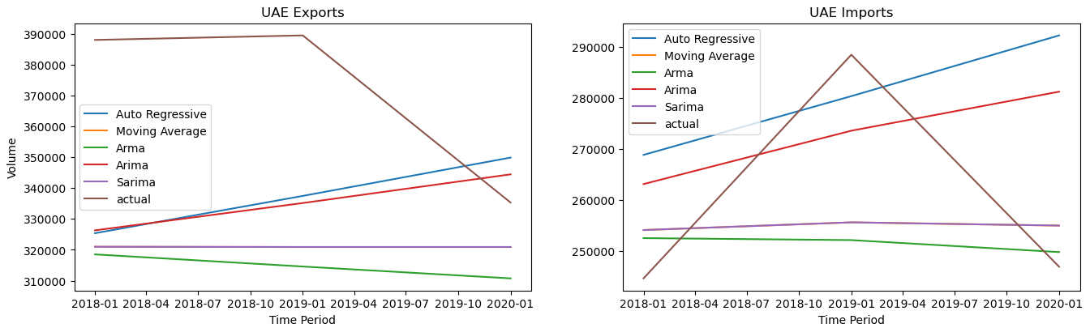
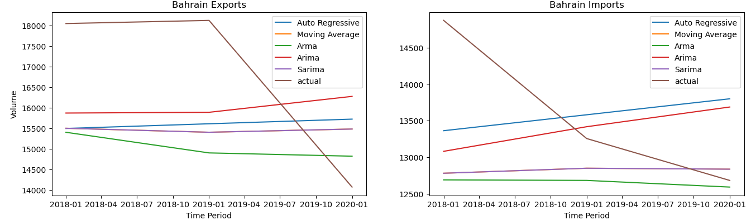

Slide 7
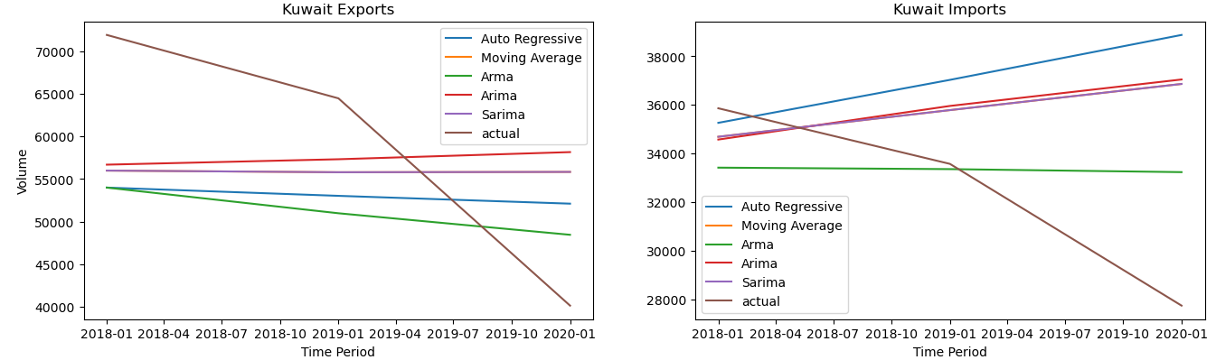
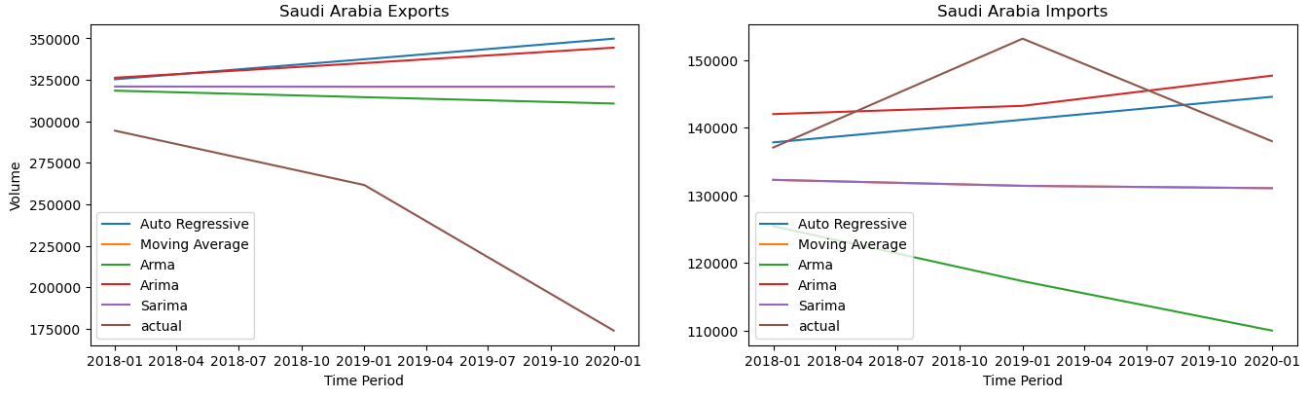

Slide 8

Phase 2 – Focus on Import / Export Products of UAE
Adding Ensemble models, Exponential Smoothing model - Bagging and AdaBoost optimizers
20xx

Slide 9
Timeline
Learning Time-Series Models
Early stages of figuring out how to read in the data from six countries and what to do with the data.
Applying Different Models to Data
Looking at the Moving Average, Auto Regression, ARMA, ARIMA, and SARIMA models.
Making Sense of the Predictions
Predictions versus Actual data. Making sense of why the predictions are not lining up.
Adding more Models and Optimizers
Bringing in Exponential Smoothing and Optimizers. Spending time configuring the models.
Testing Predictions
Working as a group to decide how we could utilize our models to attempt actual simple predictions.

Slide 10
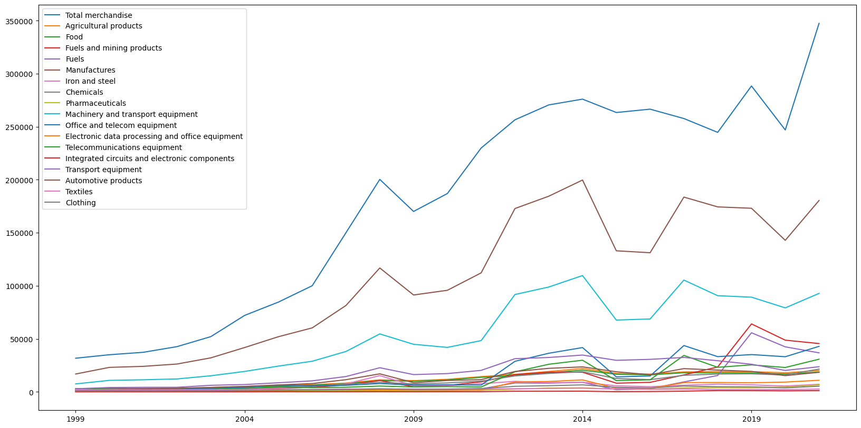
UAE Imports

Slide 11

Opportunities and Defeats
Models
Model Performance
Graphing Data
Trying and failing at other models
Representative sample of our models

Slide 12
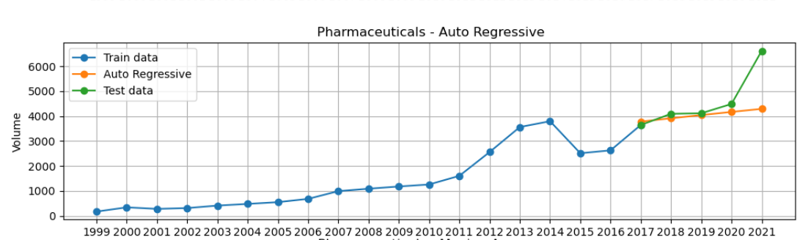
Auto Regressive (AR) - Imports

Slide 13
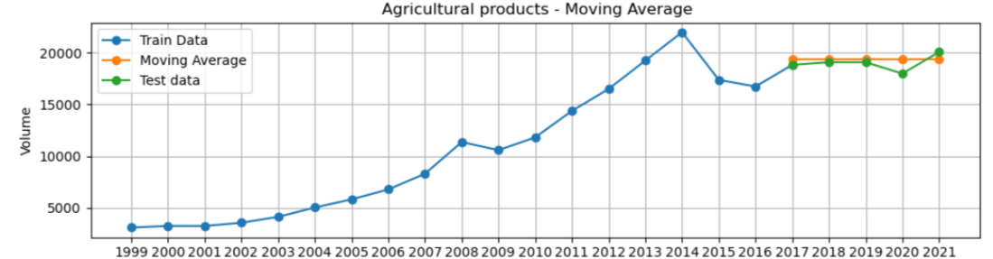
Moving Average (MA) - Imports

Slide 14
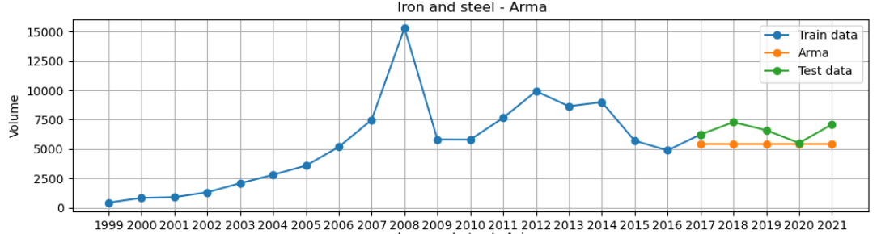
ARMA - Imports

Slide 15
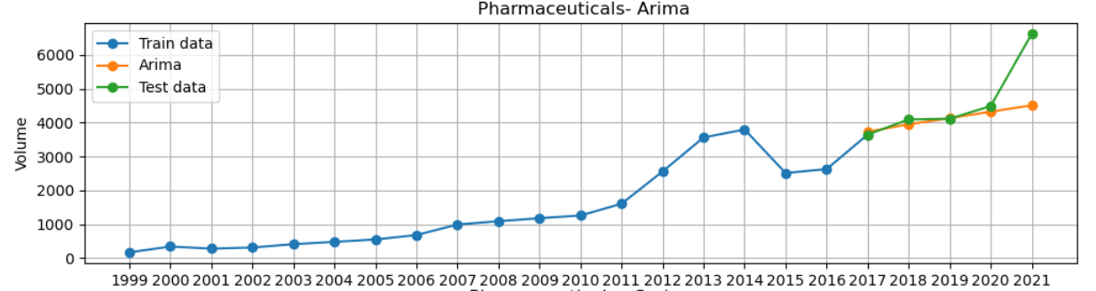
ARIMA - Imports

Slide 16
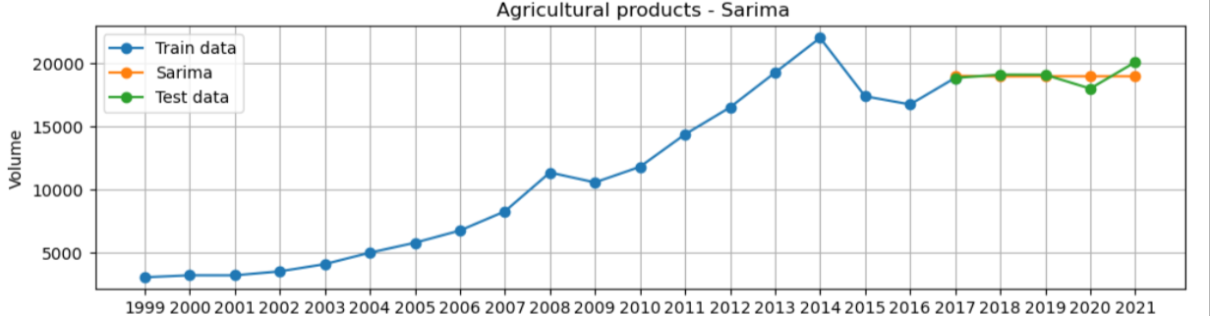
SARIMA - Imports

Slide 17
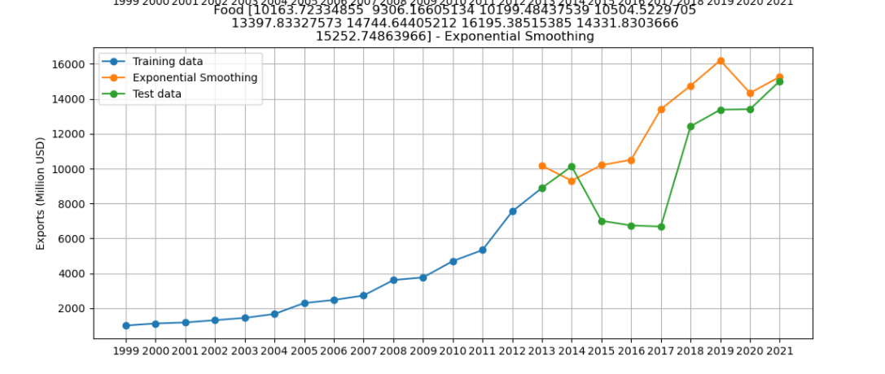
Exponential Smoothing - Exports

Slide 18
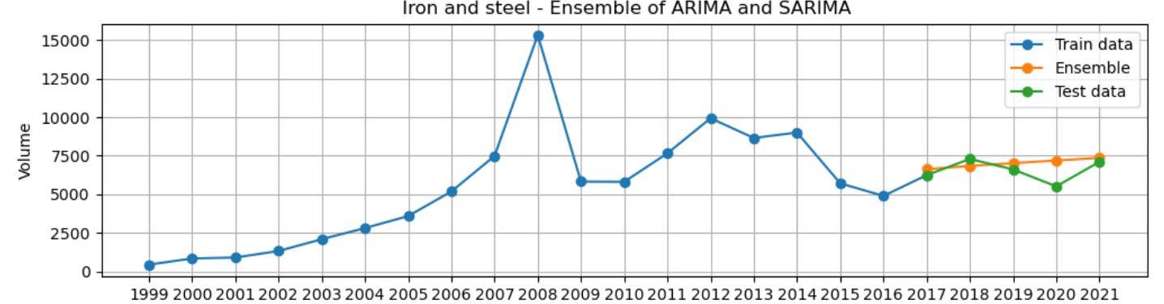
Ensemble ARIMA & SARIMA - Imports

Slide 19
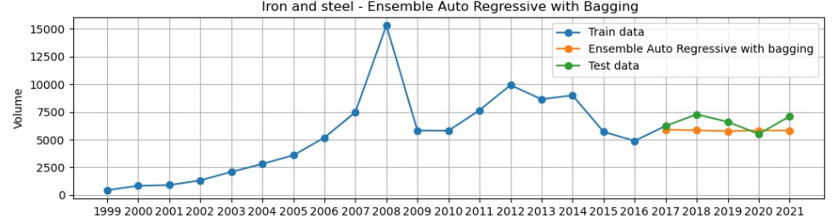
Ensemble AR with Bagging - Imports

Slide 20
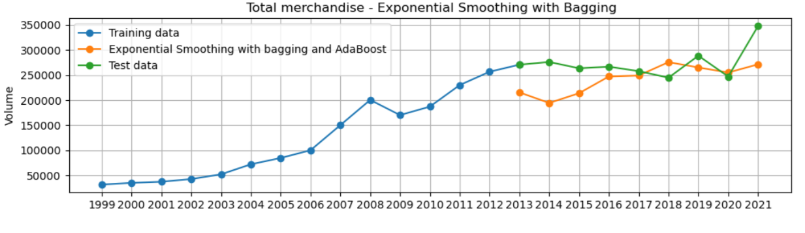
Exponential Smoothing with Bagging and Adaboost - Imports

Slide 21
Evaluation Metrics
The evaluation metrics considered in this analysis are R2 score, mean absolute percentage error ("MAPE"), and symmetric mean absolute percentage error ("SMAPE"). The R2 score indicates the proportion of variation in the dependent variable (actual values) that can be explained by the independent variable (predicted values). A higher R2 score indicates a better fit between actual and predicted values. MAPE and SMAPE indicate the average magnitude of the prediction errors as a percentage of actual values. Lower values of MAPE and SMAPE indicate a more accurate prediction.

Slide 22
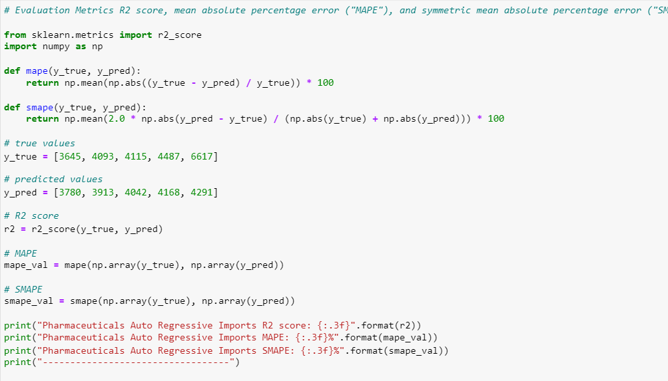
Evaluation Metrics code

Slide 23
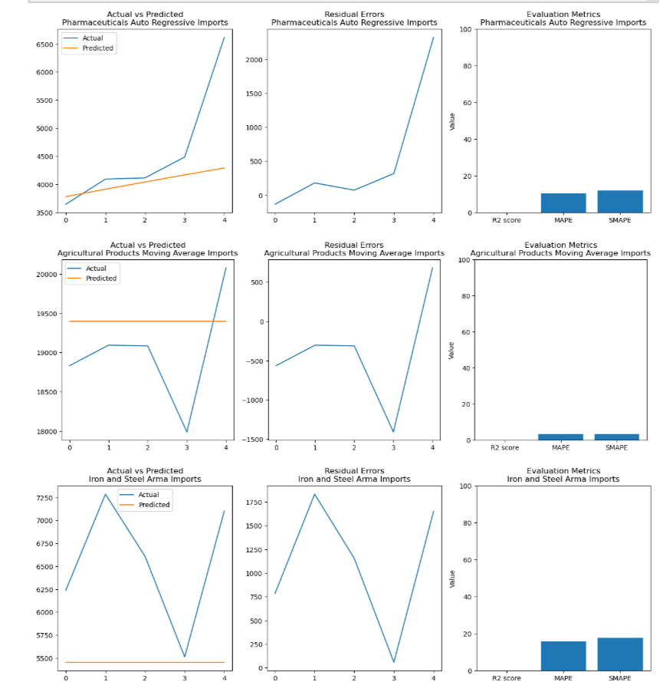
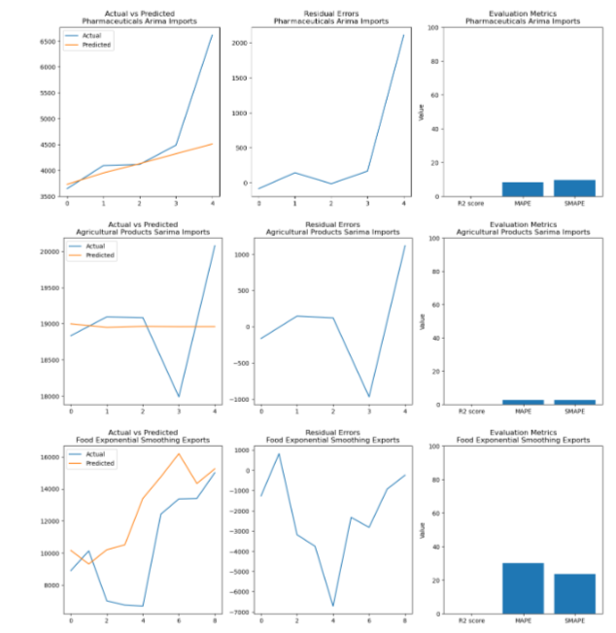
Evaluation Metrics visualization

Slide 24
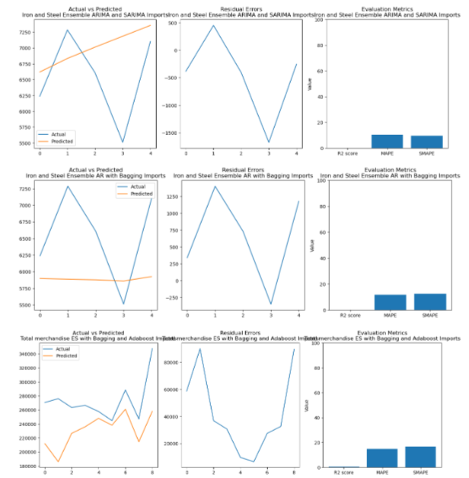
Evaluation Metrics visualization

Slide 25
Observations
Among the exports and imports of the country, we have noted that the majority of our models predicted the imports more accurately due to:
imports being less influenced by fewer variables than exports. When a country imports goods, it has more control over the factors that affect the flow of goods, such as the transportation and logistics, customs regulations, and tariffs.
On the other hand, when a country exports goods, it is subject to more external factors that are often outside of its control, such as the economic conditions of other countries, political instability, and fluctuations in currency exchange rates.
It can be difficult to obtain accurate data on exports, especially in developing countries where customs reporting may be less consistent or where informal trade is more common.
Among the evaluated models:
Exponential Smoothing with Bagging and Adaboost for the Total Merchandise Products Import segment has the highest R2 score of 0.695, indicating that it can explain 69.5% of the variation in actual values using predicted values. The model also has a MAPE of 14.970% and an SMAPE of 16.755%, indicating a reasonably accurate prediction of future imports and exports from the UAE.
Arma for the iron and steel products import segment had the lowest R2 score of -2.962, indicating a poor fit between actual and predicted values.
Sarima model for agricultural product import had the lowest MAPE and SMAPE, indicating a more accurate prediction than other models. However, its R2 score is low at -0.012, indicating that the model can explain only a small proportion of the variation in actual values using predicted values.

Slide 26
Prediction of simple scenarios
Utilizing the Exponential Smoothing model, we applied simple predictions
The model was fed with all the data we had for a product and then applied the model. A simple prediction change was added to show impact based on the average negative scenario.
A user can pick a percentage to have the market impacted and see how the scenario reacts.
The example given shows a 16% decrease.

Slide 27
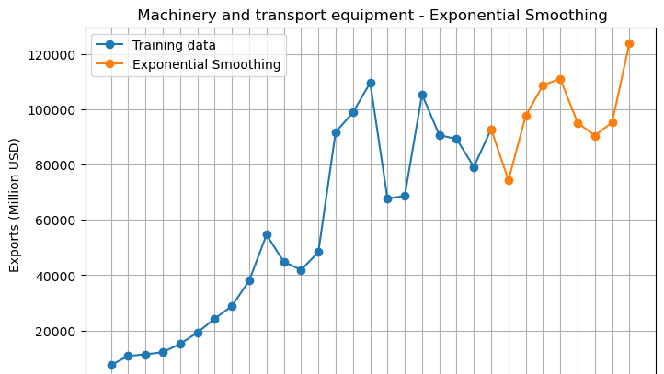
Exponential Smoothing showing simple reduction of 16%

Slide 28

Summary
The results of this analysis highlight the challenges of predicting future trends in a complex and dynamic global trade market, where various external factors can influence imports and exports.
Other external variables were not taken into consideration in our models, such as political instability, economic conditions, and fluctuations in currency exchange rates, all of which can affect the flow of goods across borders.
Furthermore, we found it difficult to find sufficient training data, which is most likely affecting the predictive capabilities of our models.
For future research on this subject, it is crucial that alternative datasets accounting for external economic and political variables are incorporated into the ML models.

Slide 29



THANK YOU

